Slide 1
Week 3 Updates: SolidWorks DFM Plug-In
Ruoyu Song
Dr. Cassandra Telenko
Aniruddh Marellapudi

Slide 2
Updates from Week 3
Added feature tree traversal. Loop structure as follows:
Get all features
Get all sketches underlying each feature
Get all pertinent dimensions of sketches and features
Added specific feature data retrieval
Sketch dimensions, extrusion depth, hole diameter, hole depth
Still a lot to do in that we need to deal with many more features
Added feature highlighting
Decided on new UI for setting feature tolerances

Slide 3
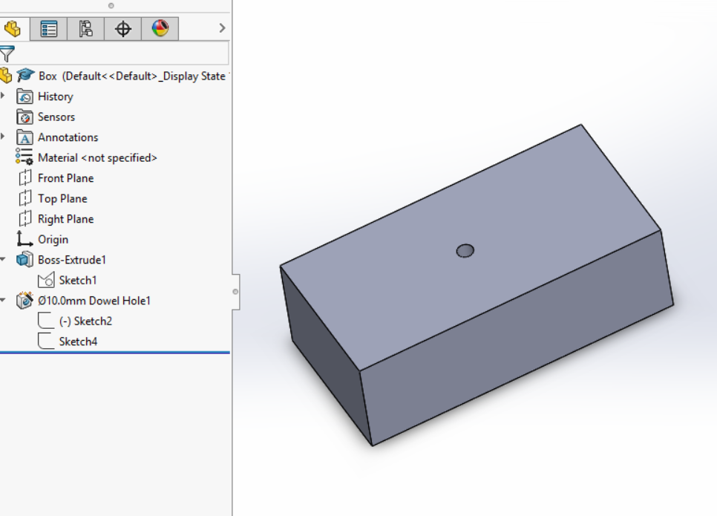
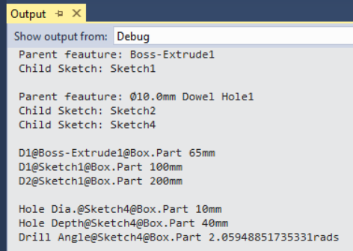

Slide 4
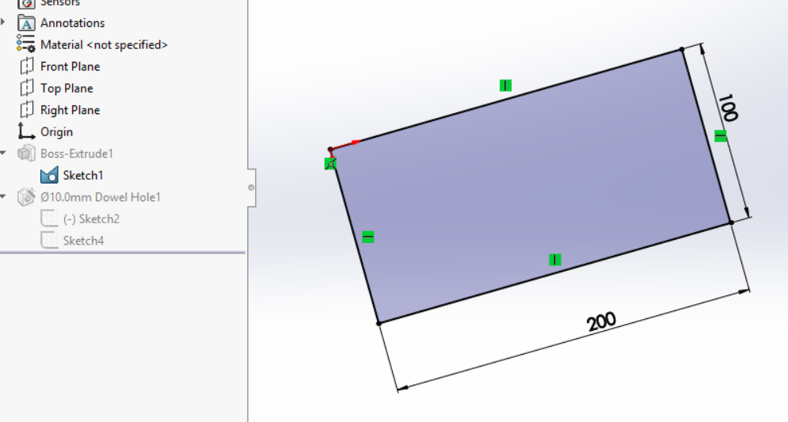

Slide 5
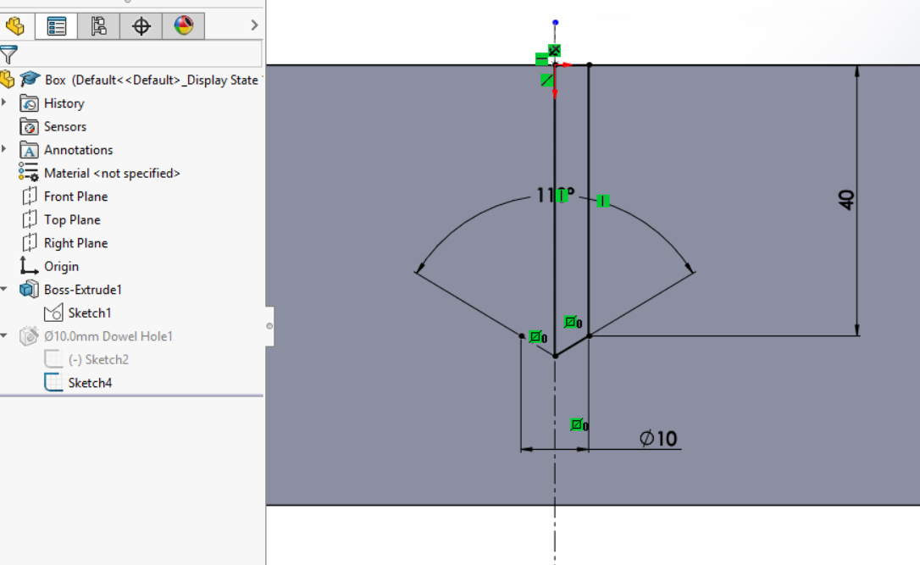

Slide 6
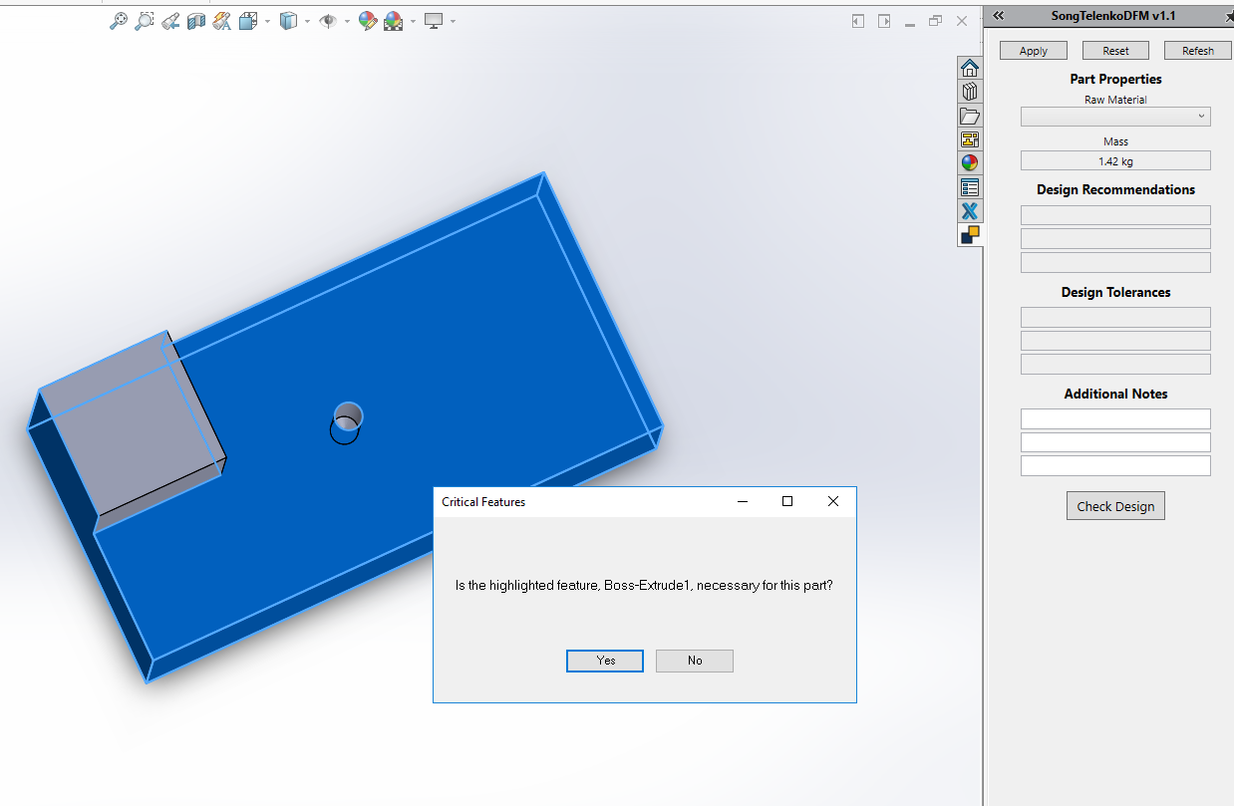

Slide 7
Next Steps
Interface with SculptPrint
We can run a python script from within C#
Experiment with this, and with finding an automatic fixturing process
Dynamically show the SculptPrint results in the plug-in
This might involve network communications and another computer
Document everything thoroughly. This project is confusing to set-up, so I will make a guide

Slide 8
Quick Project Decisions
Need a proper name and description to display in SolidWorks

Slide 9
Problems List and Solution
AngelSix Add-In Installer returns with an error
The add-in installer runs RegAsm.exe to register your plug-in’s .dll
Can debug manually
cd C:\Windows\Microsoft.NET\Framework64\v4.0.30319
RegAsm.exe /codebase "C:\Users\Aniruddh\Desktop\solidworks-api-develop\Tutorials\DynamicReload\DynamicReload\bin\Debug\DynamicReload.dll"

Slide 10
Problems List and Solution (Cont’d)
Packages downloaded from GitHub do not compile because Dna.Framework is not a valid namespace
Dna.Framework, also written by AngelSix, is a NuGet package
NuGet is a free, open-source package manager in Visual Studio
Make sure this package is properly installed (with dependencies) for each solution

Slide 11
Problems List and Solution (Cont’d)
Make sure SolidWorks Interop files (SolidWorks Native API) have the same version as those referenced by AngelSix API
AngelSix API uses .NET Framework 4.7.1, so make sure this is consistent with your solution

Slide 12
Problems List and Solution (Cont’d)
Installing add-in shows too many Command Manager Items
Renaming the project when you have a Command Manager Item plug-in causes this
Have not found the fix so far
Possible walk-around: clone the project, and export a new .dll

